Slide 1
Double Replacement Reactions

Slide 2
The Basics!
This type of reaction has a positive ion and a negative ion switching places
A⁺B⁻ + C⁺D⁻ → A⁺D⁻ + C⁺B⁻
A Double Replacement Reaction will usually produce:
A gas
A precipitate
A molecular compound
(like water)
If the Products are 2 aqueous solutions, no chemical rxn has occurred
Ex. BaCl₂ + MgSO₄ → BaSO₄ + MgCl₂

Slide 3
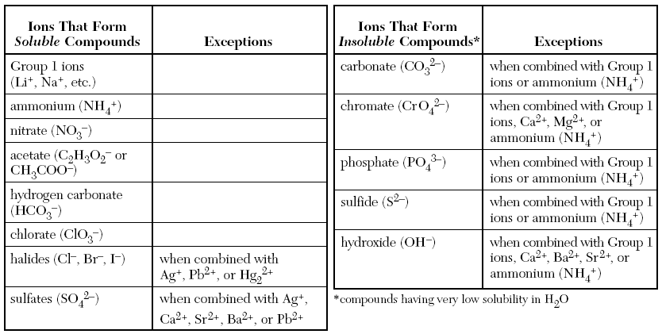
Solubility Chart

Slide 4
Predicting the Products of a Double Replacement Reaction
Given the reactants, write the name of the products by switching the LAST names
Do not use acid names; use FULL NAME
ex: Don’t use Nitrous Acid; use Hydrogen Nitrite
Check the Table of Solubility Rules
If something is insoluble → it will form a precipitate (s) during the rxn
RXN WILL OCCUR
If a liquid/ gas has formed
RXN WILL OCCUR
If something is soluble → it will form an aqueous (aq) product
(If you finish with 2 soluble (aq) reactants)
NO RXN (stop there)

Slide 5
The Exceptions!
5 things that may seem soluble, but will actually produce a liquid or a gas → a reaction WILL occur
If any of these are a product, there will be a rxn
Hydrogen Carbonate → breaks into water and Carbon Dioxide
H₂CO_{3 (aq)} → H₂O _{(l)} + SO_{2 (g)}
if you make Hydrogen Carbonate, the CO₂ bubbles (gas) produced = rxn
Hydrogen Sulfite → breaks into water and Sulfur Dioxide
H₂SO_{3 (aq)} → H₂O _{(l)} + SO_{2 (g)}
Ammonium Nitrate → breaks into water and Ammonia
NH₄OH _{(aq)} → H₂O _{(l)} + NH_{3 (g)}

Slide 6
Exceptions (cont.)
Hydrogen Sulfide - H₂S
Odor produced (rotten eggs)
Hydrogen Hydroxide – HOH
Water H₂O _{(l)} (which is a rxn)

