Slide 1
We NEED a campus garden.
Mr. W’s Garden Plan

Slide 2
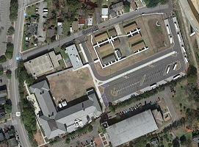
Where is it going to be?
Charleston Charter School for Math and Science
We are proposing to build in the area between the car loop and the first row of trailers.

Slide 3
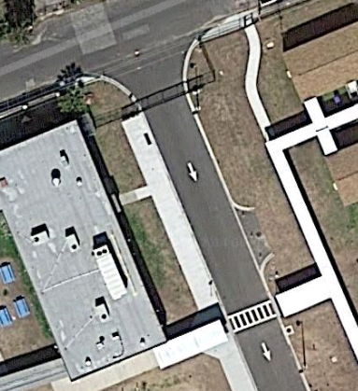
Why this area?
Dominantly sun throughout the day.
Easy for people to see.
In sight, in mind!
Currently no building plans for this area.

Slide 4
Our project constraints
Each garden bed is no wider than 4ft and no longer than 12 ft.
Does not block personal from walking.
Will not damage any property.
Is at least 3ft from any sidewalk or wall.

Slide 5
Step 1: Measure the area
Accurate measure the area.
Produce a sketch of the area.
Include areas of concern or obstructions.

Slide 6
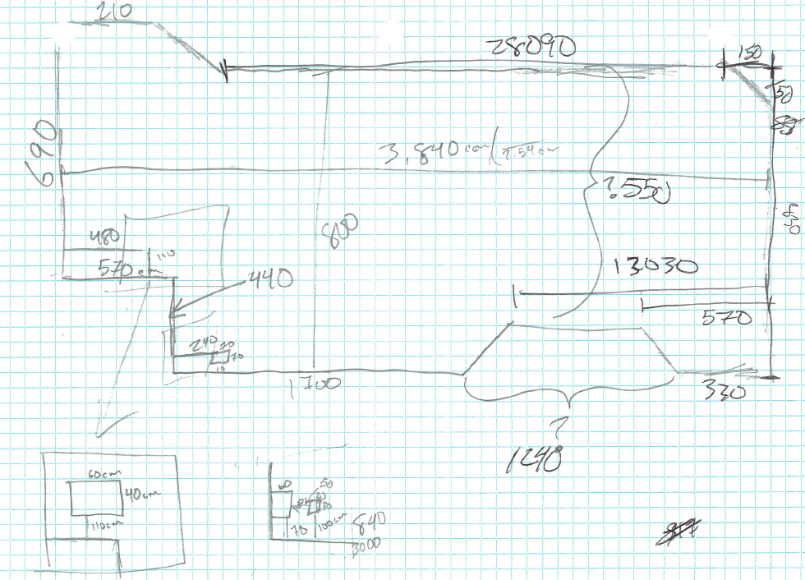
Step 2: Produce a blueprint to scale.
Convert the measurements to one unit.
Identify the proportion of the value to one box.
Repeated the drawing in an additional unit.
Draw the area to scale.

Slide 7
Step 2: Produce a blueprint to scale.
Convert the measurements to one unit.
Identify the proportion of the value to one box.
Draw the area to scale.
Repeated the drawing in an additional unit.

Slide 8
Step 3: Consider the restrictions.
Will not damage any property.
Dark shaded area is infrastructure that must be avoided.
Is at least 3ft from any sidewalk or wall.
Light shaded area is the no building zone from all edges.

Slide 9
Step 4: Determine development plan.
Area of least constraints.
Easily seen.
Easily accessed.
Not along a teacher’s trailer.

Slide 10
Step 4: Determine development area.
Area allows for 4 garden beds to be 4ft wide
With extra space.
The extra space will be used to have benches on the planters.
Each garden bed will be 10ft long.
Each bench will seat approximately 5 people.
Total maximum seating: 40 people.
Similar idea found at chickengardener.com

Slide 11
Step 5: Materials Needed.
TBD

Slide 12
Why is this needed?
Students deserve the ability to learn hands on about the growth of produce.
It relates to classes curriculum.
6th grade science (Plants)
Biology (Ecology)
Health (Healthy Food)
English (Naturalist studies)
Physics (Measurements and Conversions)
Engineering (Civil development)
Visually improving for the campus
Great Press!
Develop an outdoor classroom area

Slide 13
Sources
Pictures:
Google Maps
http://communityblueprint.com/projects/school-garden-video/
http://www.schoolgardenwizard.org/
http://www.cityschoolyardgarden.org/kids-blog/
http://www.letsmove.gov/school-garden-checklist

