Slide 1
Polyatomic Ions and Compounds

Slide 2
Thus far…
All the ions so far have been mono-atomic (single atom) ions.
For example, the Al3+ ion has only one atom: an aluminum atom.
Some ions are made of more than one atom.

Slide 3
Polyatomic Ions
The prefix “poly” means many or much.
Polyatomic ions are ions that are made up of more than one element.
Ironically, polyatomic ions are created when atoms of two or more elements are covalently bonded so that all of the atoms have a full octet of valence electrons.
However, in doing so they do not have an equal amount of electrons and protons, therefore an ion is created instead of a neutral molecule.

Slide 4
Determining the Charges of Polyatomic Ions
Each polyatomic ion has a charge just like a monoatomic ion has a charge.
For example the ammonium ion has a positive charge of 1 and the sulfate ion has a negative charge of 2.
While it is relatively simple to predict the charge of a monoatomic ion using the periodic table, it is more difficult to predict the charge of a polyatomic ion using the periodic table.
It’s best to use the charge sheet to memorize the names, formulas and charges of the common polyatomic ions

Slide 5
Polyatomic Cations
Ammonium: NH4+
The only polyatomic cation you need to know.

Slide 6
Polyatomic Anions: suffix “ate”
(Greatest Number of Oxygens)
Nitrate: NO₃⁻
Carbonate: CO₃²⁻
Sulfate: SO₄²⁻
Phosphate: PO₄³⁻
Acetate: C₂H₃O₂⁻
Chromate: CrO₄²⁻
Dicromate: Cr₂O₇²⁻
Chlorate: ClO₃⁻

Slide 7
Polyatomic Anions: suffix “ite”
(One less Oxygen than “ate”)
Nitrite: NO₂⁻
Sulfite: SO₃²⁻
Phosphite: PO₃³⁻

Slide 8
Polyatomic Anions: Hydrogen prefix
Bicarbonate: HCO₃⁻
Hydrogen Sulfate: HSO₄⁻
Hydrogen Sulfite: HSO₃⁻
Dihydrogen Phosphate: H₂PO₄⁻
Hydrogen Phosphate: HPO₄²⁻
Other Polyatomic Anions
Cyanide: CN⁻
Hydroxide: OH⁻

Slide 9
Caution:
If ions are written as a group, use parentheses to represent multiple compounds.
Ex: Mg(SO₄)₂, Al(NO₃)₃
The net charge of the compound must be neutral (0).
For a compound containing calcium ion, Ca²⁺, and nitrate, NO₃⁻,
The ratio must be 1:2 (one calcium ion for every two nitrates).
So, the formula would be Ca(NO₃)2.

Slide 10
More Names of Polyatomic Ions
The names of common polyatomic anions
Some end in ate.
NO₃⁻ nitrate PO₄³⁻ phosphate
Some end in ite.
NO₂⁻ nitrite PO₃³⁻ phosphite
Some will have hydrogen in name (or bi).
HCO₃⁻ hydrogen carbonate (bicarbonate)
HSO₃⁻ hydrogen sulfite (bisulfite)

Slide 11
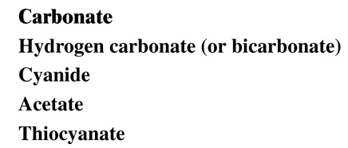
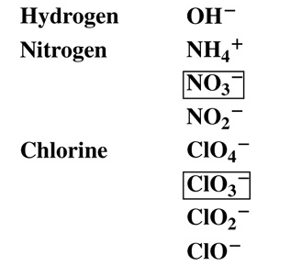
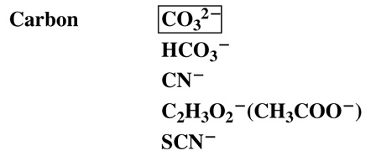
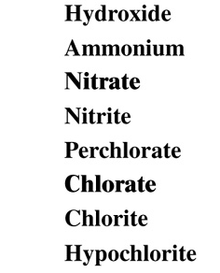
Names and Formulas of Common Polyatomic Ions
Copyright © 2008 by Pearson Education, Inc.
Publishing as Benjamin Cummings

Slide 12
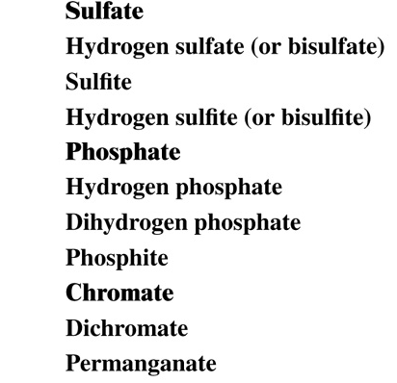
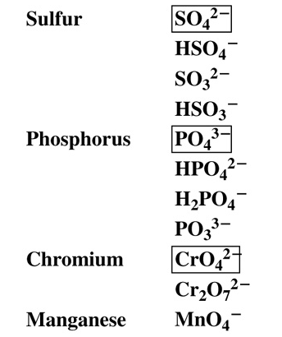
Names and Formulas of Common Polyatomic Ions
Copyright © 2008 by Pearson Education, Inc.
Publishing as Benjamin Cummings

Slide 13
Prefixes for Names of Polyatomic Ions of Halogens
Similar polyatomic ions will have similar names.
ClO₄⁻ perchlorate one oxygen more
ClO₃⁻ chlorate most common form
ClO₂⁻ chlorite one oxygen less
ClO⁻ hypochlorite two oxygens less

Slide 14
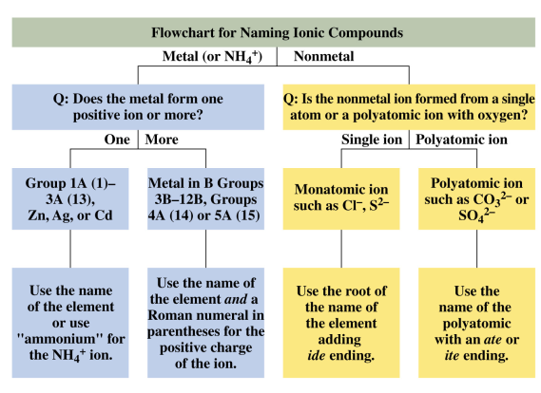
Flowchart for Naming
Copyright © 2008 by Pearson Education, Inc. Publishing as Benjamin Cummings

