Slide 1
Bonding!

Slide 2
Chemical Bond
An attraction between atoms that allows the formation of chemical substances that contain two or more atoms.
We will learn two major types of bonds.
Covalent
Ionic
The goal of all atoms is to be stable, 8 valence electrons, they will borrow, steal, or give to have 8.

Slide 3
Covalent Bond
The chemical bond that forms between nonmetal atoms when they share electrons is called a covalent bond.
Any combination of nonmetals.
In covalent bonds, electrons are shared in order to reach 8 valence electrons.

Slide 4
Covalent Bond
https://www.youtube.com/watch?v=1wpDicW_MQQ
Shared electrons are attracted to the nuclei of both atoms.
They move back and forth between the outer energy levels of each atom in the covalent bond.
Each atom has a stable outer energy level some of the time.

Slide 5
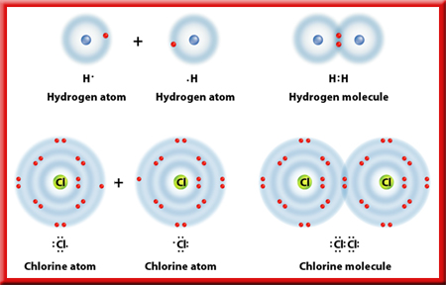
Covalent Bond
The neutral particle is formed when atoms share electrons is called a molecule

Slide 6
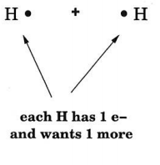
Showing Covalent Bonds
To show a covalent bond, we begin with dot notation of the two elements.

Slide 7
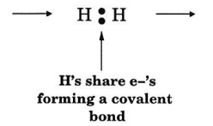
Showing Covalent Bonds
Then combine the two dot notations:
This should show each element with a full outer shell.

Slide 8
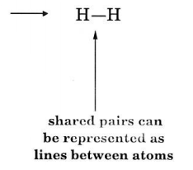
Showing Covalent Bonds
Then change the two dots to a line to represent the sharing between electrons:

Slide 9
Writing Covalent Bonds
Covalent bonds and also known as molecular compounds.

Slide 10
Interpreting Formulas
Element
Number of each Element

Slide 11
Practice
Show the bonding for two Chlorine, Cl, atoms:
Remember chlorine has 7 valence electrons.

Slide 12
Types of Covalent Bonds
Single Bond (Single Line)
Share two electrons, 1 each
Double Bond (Two Lines)
Share four electrons, 2 each
Triple Bond (Three Lines)
Share six electrons, 3 each

