Slide 1
Limiting Reactants

Slide 2
Consider the following reactions
BaCl₂ + MgSO₄ → BaSO₄ + MgCl₂
2KI + Pb(NO3)2 → PbI2 + 2KNO3
Fe + H20 (g) → Fe2O3 + H2
All reactions have two reactants yielding the reaction.

Slide 3
What is a limiting reactant?
The reactant that limits the production of the reaction.
What about the other reactant?
The excess reactant is the one that is not limited and has substance remaining after the reaction.

Slide 4
If you start with moles of a reactant.
Convert given mass to moles of the given.
Identify the mole ratio within the reaction of reactants to product.
Convert the moles of the given to moles of the product
Repeat this process for the other value of the given reactant.
Convert to the same product as before.
Value that converts into a lesser mole value for the product is the limiting reactant.

Slide 5
Determining Mole ratio
For example:
2KI + Pb(NO3)₂ → PbI₂ + 2KNO₃
The mole ratios:
2 KI to 1 PbI₂
2 KI to 2 KNO₃
Pb(NO₃)₂ to PbI₂
Pb(NO₃)₂ to 2KNO₃

Slide 6
Limiting Reactant - Practice
The black oxide of iron, Fe₃O₄, occurs in nature as the mineral magnetite. This substance can also be made in the laboratory by the reaction between red-hot iron and steam.
3Fe + 4H₂0 → Fe₃O₄ + 4H₂
When 36.0g of H₂Ois mixed with 67.0g Fe, which is the limiting reactant?

Slide 7
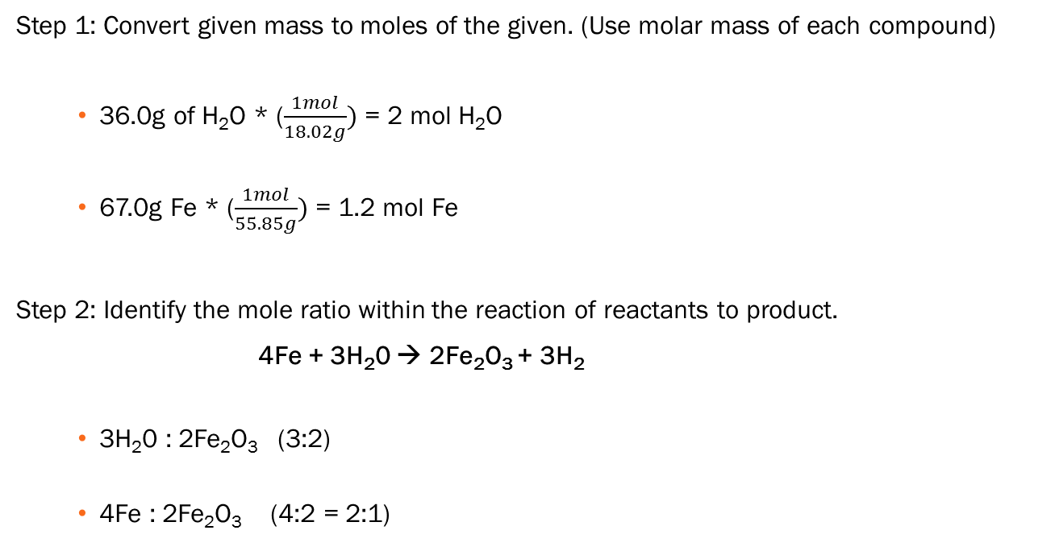
Solve:
Step 1: Convert given mass to moles of the given. (Use molar mass of each compound)
36.0g of H₂O * ($\frac{1mol}{18.02g})$ = 2 mol H₂O
67.0g Fe * ($\frac{1mol}{55.85g})$ = 1.2 mol Fe
Step 2: Identify the mole ratio within the reaction of reactants to product.
4Fe + 3H₂0 → 2Fe₂O₃ + 3H₂
3H₂0 : 2Fe₂O₃ (3:2)
4Fe : 2Fe₂O₃ (4:2 = 2:1)

Slide 8
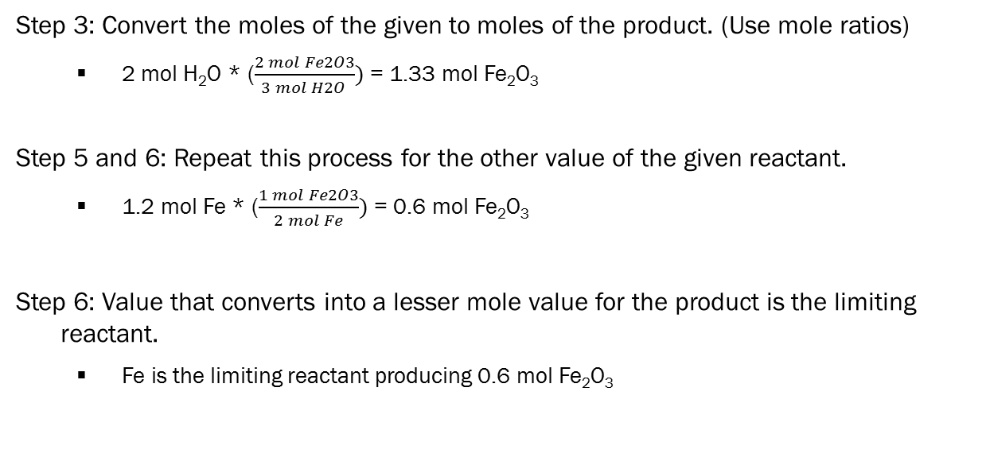
Solve:
Step 3: Convert the moles of the given to moles of the product. (Use mole ratios)
2 mol H₂O * ($\frac{2 mol Fe2O3}{3 mol H2O })$ = 1.33 mol Fe₂O₃
Step 5 and 6: Repeat this process for the other value of the given reactant.
1.2 mol Fe * ($\frac{1 mol Fe2O3}{2 mol Fe})$ = 0.6 mol Fe₂O₃
Step 6: Value that converts into a lesser mole value for the product is the limiting reactant.
Fe is the limiting reactant producing 0.6 mol Fe₂O₃

Slide 9
Determine mass of product
A remaining reactant has material left after the reaction is completed.
To determine mass:
Determine moles of product produced by limiting reactant
Convert moles of product to mass of the product using molar mass.

Slide 10
Limiting Reactant - Practice
Considering the reaction of the black iron oxide, Fe₃O₄,
3Fe + 4H₂0 → Fe₃O₄ + 4H₂
What mass in grams of black iron oxide is produced?

Slide 11
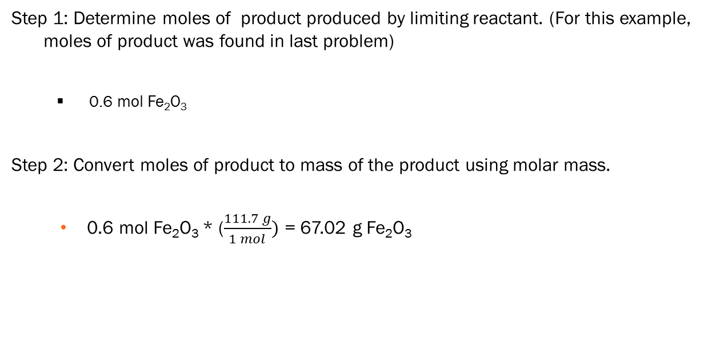
Limiting Reactant - Practice
Step 1: Determine moles of product produced by limiting reactant. (For this example, moles of product was found in last problem)
0.6 mol Fe₂O₃
Step 2: Convert moles of product to mass of the product using molar mass.
0.6 mol Fe₂O₃ * ($\frac{111.7 g}{1 mol})$ = 67.02 g Fe₂O₃

Slide 12
remaining mass of excess reactant
A remaining reactant has material left after the reaction is completed.
To determine mass:
Determine moles of product produced by limiting reactant
Use moles ratio to determine the amount of moles for the excess reactant.
Use the molar mass of the excess reactant to convert moles to mass.
Find the difference between the given amount of reactant and the amount used in the reaction.

Slide 13
Limiting Reactant - Practice
Considering the reaction of the black iron oxide, Fe₃O₄,
3Fe + 4H₂0 → Fe₃O₄ + 4H₂
What mass in grams of excess reactant remains when the reaction is produced?

Slide 14
Limiting Reactant - Practice
Step 1: Determine moles of product produced by limiting reactant.
(For this problem the moles of product was found in the first problem)
0.6 mol Fe₂O₃
Step 2: Use moles ratio to determine the amount of moles for the excess reactant.
0.6 mol Fe₂O₃ * ($\frac{3 mol H2O}{2 mol Fe2O3})$ = 0.9 mol H₂O
Step 3: Use the molar mass of the excess reactant to convert moles to mass.
0.9 mol H₂O * ($\frac{18.02g}{1mol})$ = 16.22 g H₂O
Step 4: Find the difference between the given amount of reactant and the amount used in the reaction.
36 g - 16.22 g = 19.78 g H₂O

Slide 15
Percentage Yield
In real life it is a common saying that “things did not go as planned”
Reactions are the same.
The chemical reactions that we write are considered theoretical (ideal) yield.
Theoretical Yield: the maximum amount of product that can be produced from a given amount of reactant.
In a lab, the material that is produced is considered the actual yield.
Actual Yield: measured amount of a product obtained from a reaction.

Slide 16
Percentage Yield
Percentage yield is the percentage of the ratio between the actual yield to the theoretical yield.
actual yield x100
theoretical yield

Slide 17
Percentage Yield - Practice
Chlorobenzene, C₆H₅Cl, is used in the production of asprin, dyes, and disinfectants. One industrial method of preparing chlorobenzene is to react benzene, C₆H₆ with chlorine.
C₆H₆ + Cl₂ → C₆H₅Cl + HCl
When 36.8g of C₆H₆ react with an excess of Cl₂, the actual yield of C₆H₅Cl is 38.8g.
What is the percentage yield of C₆H₅Cl ?
To solve this problem identify the mass produced by the limiting reactant C₆H₆ as done before)

