Slide 1
Scalars v. Vectors

Slide 2
Understanding Motion
A study of motion will involve the introduction of a variety of quantities that are used to describe the physical world.
All quantities can by divided into two categories
Vectors
Scalars

Slide 3
Vector
Scalar
A quantity is a quantity that is fully described by its magnitude.
A quantity is a quantity that is fully described by both magnitude and direction.

Slide 4
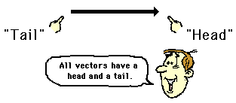
Drawing Vectors
A vector arrow is drawn in a specified direction.
The vector arrow has a head and a tail.
Vector quantities are often represented by scaled Vector diagrams, a vector drawn to scale in a specific direction.

Slide 5
Direction
Often we refer to directions by common phrases:
(on the axis) (45° between axis)
Although, objects don’t always move in such simple directions.
North
East
West
South
Northeast
Southwest
Northwest
Southeast

Slide 6
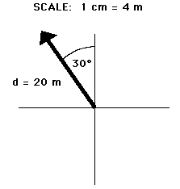
Representing Direction
Consider the drawing:
The angle is not on or does it split the axis.
Consider the tail is attached to the center and has swiveled to an angle.

Slide 7
Option 1
Assume that the arrow has swiveled off of north to the left.
To the left is to the west
Moved exactly 30°
Therefore the vector is 30° west of north.

Slide 8
Option 2
Considering that the vector is to the left of north.
Left is counterclockwise
Moved exactly 30°
Therefore the vector is 30° counterclockwise of north.

Slide 9
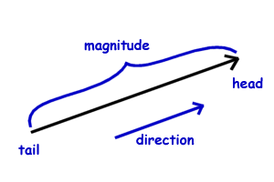
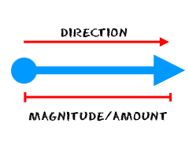
Magnitude
The magnitude of a vector is proportional to its value.
Should be represented in comparison to other values in a diagram.
OR- If a scale is being used, the arrow is drawn a precise length in accordance with the scale.

Slide 10
Vector
Examples
Scalar
10ft.
30 mph
30 mph Southeast
10ft. 25° North of west

Slide 11
Practice
Write three statements that are scalar then add necessary information to make them a vector value.

Slide 12
Summary
Scalar value is only a number (magnitude).
Vector value has a number (magnitude) and a direction.
Represented with a tail and a head.
Proportional in size to it’s value.

