Slide 1
Chapter 2
Motion in 1 Dimension

Slide 2
1 Dimension
What does motion in one dimension mean?

Slide 3
1 Dimension
What does motion in one dimension mean?
  Traveling in one direction. Such as N, E, Up, Left
  **Large Ball example**

Slide 4
Frame of Reference
Allows an object to have an starting (origin) pt.
Determines the VIEW POINT of a problem.
Once identified, it can not be changed.
DEFINITION: A system for specifying the precise location of objects in space and time

Slide 5
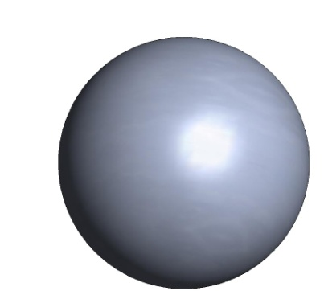

Frame of Reference
It can not be changed during a problem.
No matter where we start measuring the displacement will be the same.

Slide 6
Frame of Reference
Displacement of 7 inch
This is a change in frame of reference.

Slide 7
Displacement v. Distance
Remember:
    Displacement is the length of the straight path from final to initial position
Displacement = change of position = Δx
    Final position – initial position = X_{f} - X_{i}
    Δx = X_{f} - X_{i}

Slide 8
Displacement
Displacement= Δx = X_{f} – X_{i}
Can displacement be negative?
X_{f}
X_{i}

Slide 9
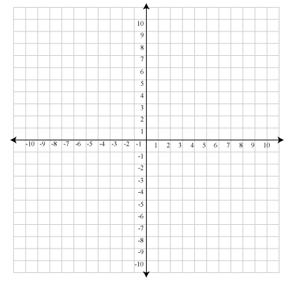
Positive and Negative Directions
Positive:
  North (up)
  East (right)
Negative
  South (down)
  West (left)

Slide 10
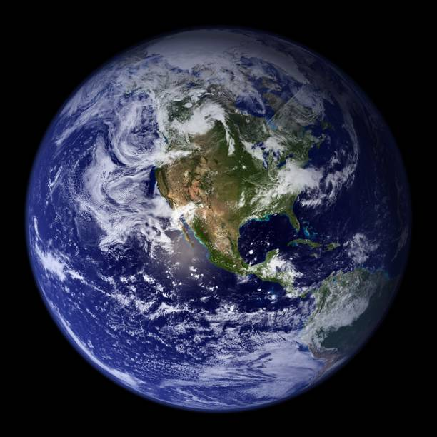
Back to motion…
Does it feel like you are moving? Because you are…
The earth is constantly
rotating on its axis, but
we don’t feel anything.

Slide 11
Motion
As an object is moving, it not only has a initial and final location/position.
It also has an initial and final time that the object traveled.
X_{i}
X_{f}

Slide 12
Average Velocity
Displacement=change of position= Δx
Change in Time = Δt = t_{f} – t_{i}
Average Velocity = Δx / Δt = (x_{f} - x_{i})/(t_{f} – t_{i})
Definition: Is defined at the displacement an object travels over the time that it took the object to travel that displacement.

Slide 13
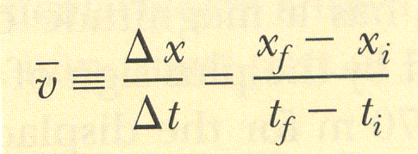
Average Velocity
Average Velocity = Δx / Δt = (x_{f} - x_{i})/(t_{f} – t_{i})
Can Average Velocity be Negative?

Slide 14
Velocity v. Speed
Speed has a distance traveled
Velocity has a displacement traveled and a direction.
Average Velocity v. Average Speed
Average speed = (distance traveled) / (Δt)
Never consider a car going a negative speed…

Slide 15
Average Velocity
Average Velocity =
What would be
the change in
displacement
over the given
interval?
Δx = (x_{f} - x_{i})

Slide 16
Average Velocity
Average Velocity =
What would be
the change in
time over the
given interval?
Δt = (t_{f} - t_{i})

Slide 17
Average Velocity
Average Velocity =
What would the
Average Velocity
of the particle
over the given
interval?

Slide 18
Average Velocity
The equation for Average Velocity is very similar to another graph formula, which one?
Average Velocity =
Slope = m = (rise/run)
Δy = (y₂ – y₁)
Δx (x₂ – x₁)

Slide 19
Notes
Although, displacement is referred to as values of x_{f} and x_{i}
Displacement is often the y exponent or dependent variable of the problem
Where as time is
considered the
independent variable.

Slide 20
Instantaneous Velocity
An object’s velocity at a particular moment along its pathway.

Slide 21
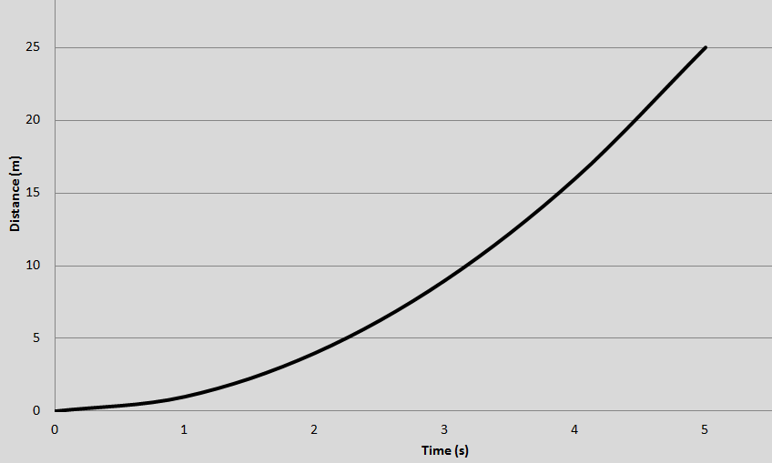
Instantaneous Velocity
An object’s velocity at a particular moment along its pathway.

Slide 22
Instantaneous Velocity
An object’s velocity at a particular moment along its pathway.

Slide 23
Instantaneous Velocity

