Slide 1
Review Section 2.1
Frame of Reference: Refers to the viewpoint of the problem and con not be changed.
Displacement = Δx = X_{f} - X_{i}
Average Velocity = Δx = (x_{f} - x_{i})
Δt (t_{f} – t_{i})

Slide 2
Chapter 2.2
Motion in 1 Dimension

Slide 3
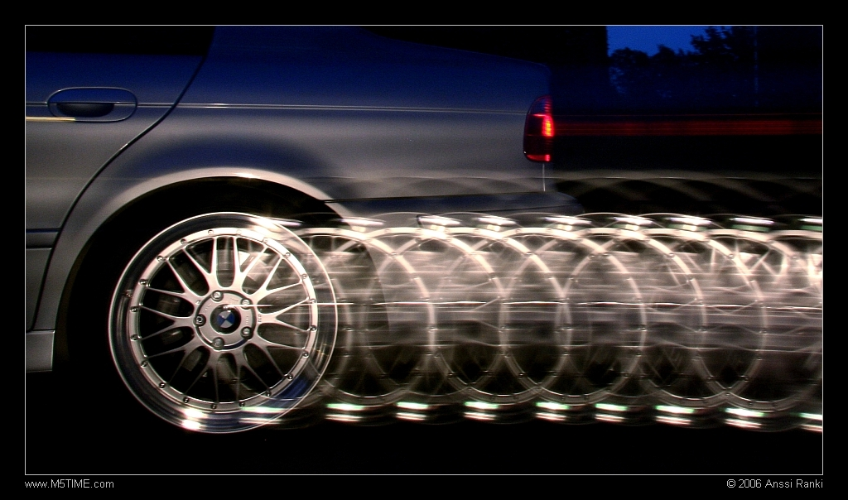
Consider a Car
A car driving at a constant 30mph to the west.
Can you determine the final location of the car given a time interval?

Slide 5
Constant Velocity
Constant velocity indicates the instantaneous velocity at any instant during a time interval is the same as the average velocity during that time interval.
V_{avg} = V_{x}

Slide 6
Constant Velocity
The mathematical representation of this situation is the equation.
Let t_{i} = 0 and the equation becomes:
x_{f} = x_{i} + v_{x} t
(for constant v_{x})

Slide 7
Consider a Car
A car is seen stopped at a street light then again going 30mph to the west.
Did the car change velocity? How?

Slide 8
Acceleration
The rate at which velocity changes over time; an object accelerates if its speed, direction, or both changes.
Average Acceleration = change in velocity
change in time

Slide 9
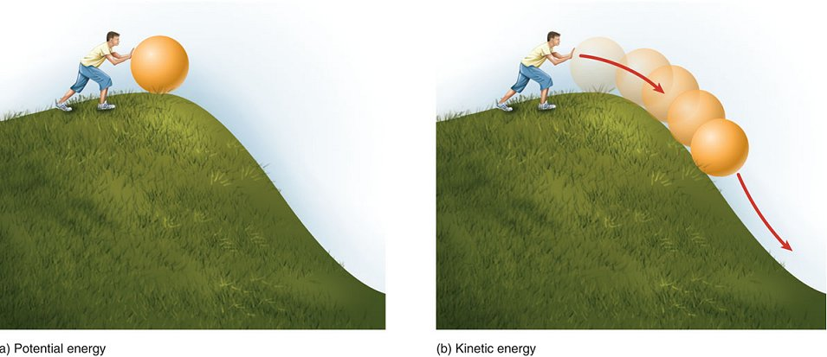
Think…
True or False:
A negative acceleration always means slowing down.

Slide 10
Think…
True or False:
A negative acceleration always means slowing down.
False.
Consider the speed in which is increased as an object falls from the sky.

Slide 11
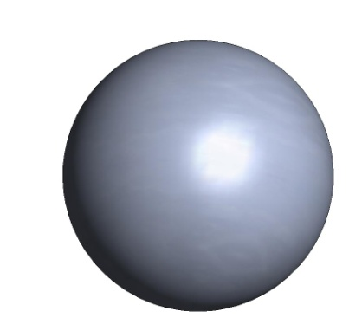
Acceleration
If acceleration is in the same direction of the velocity then it is speeding up.
In this case velocity is (+ or -)?
Acceleration?
Velocity
Acceleration

Slide 12
Acceleration
If they are in different directions the object will slow down.
In this case velocity is (+ or -)?
Acceleration?
Velocity
Acceleration

Slide 13
Acceleration

Slide 14
Notes
Motion | V_{i} | a
Speeding up | + | +
Speeding up | - | -
Slowing down | + | -
Slowing down | - | +
Constant velocity | - or + | 0
Speeding up from rest | 0 | - or +
At rest | 0 | 0

Slide 15
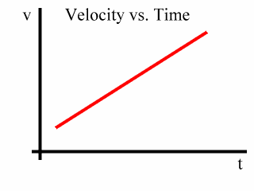
Motion with a Constant Acceleration
What does this mean?
Is there still motion occurring?
Is the velocity increasing or decreasing?

Slide 16
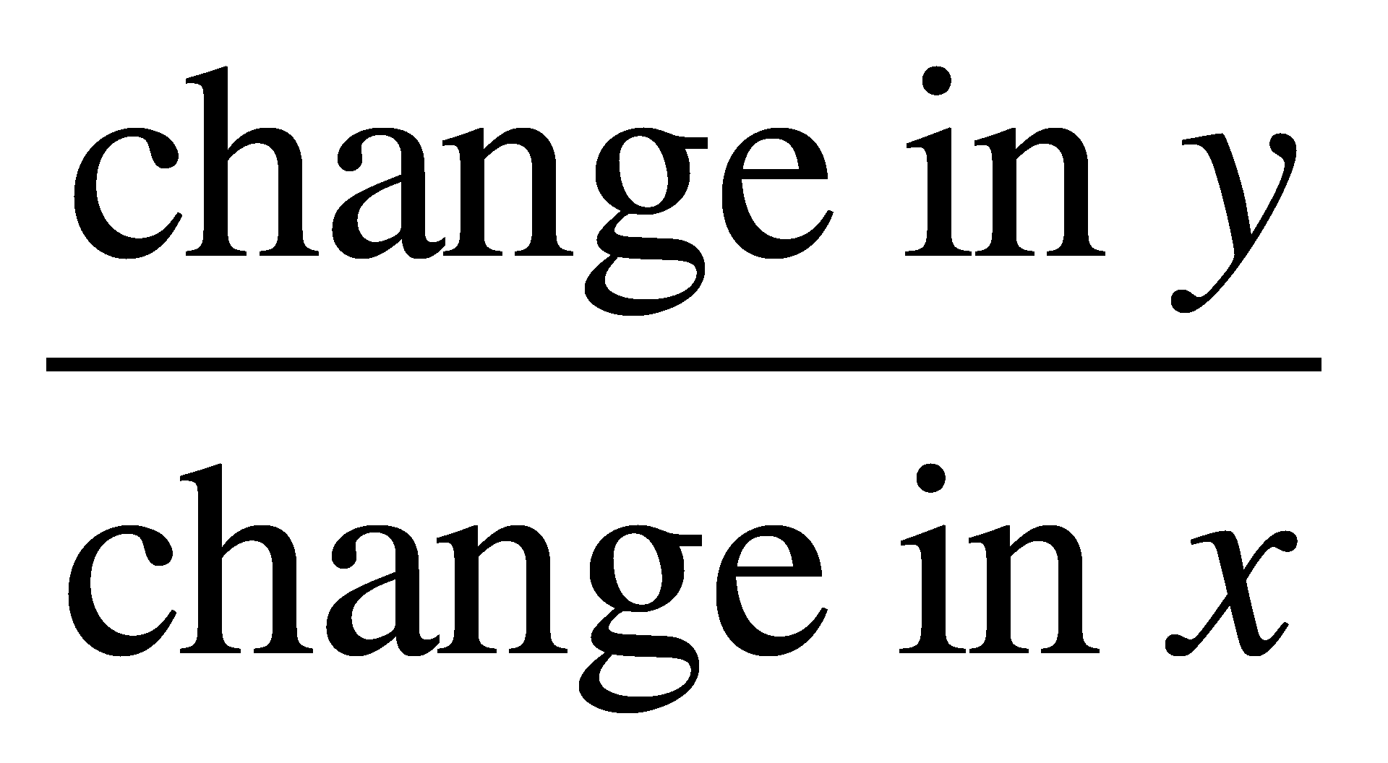
Motion with a Constant Acceleration
Slope =
=
= Acceleration

Slide 17
Consider Graphs
 | Position v. Time | Velocity v. Time
Slope: | Velocity | Acceleration
Increasing Slope | Moving Forward (positive) | Speeding Up
Decreasing Slope | Moving Backward (negative) | Slowing Down
Slope = 0 | Not Moving / Changing Directions | Constant Velocity

Slide 18
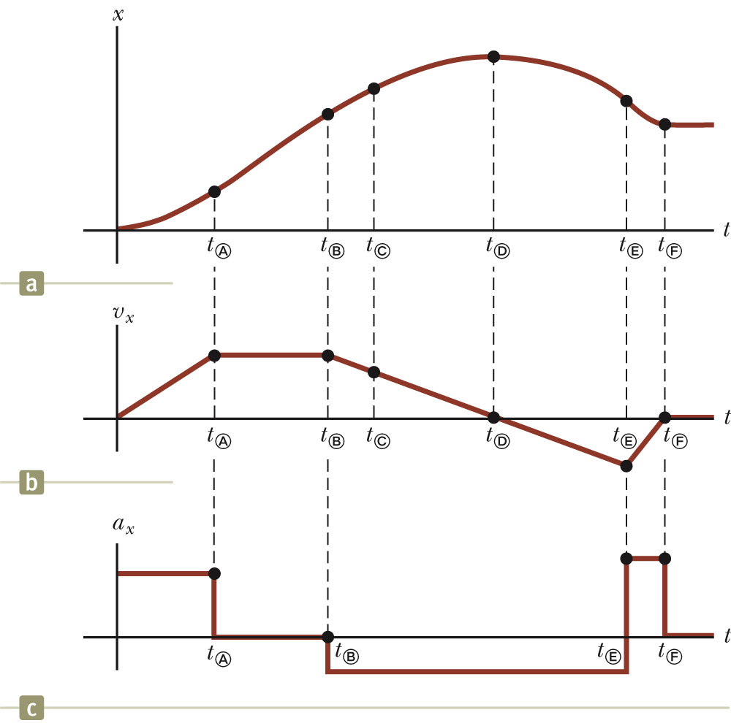
Graphical Comparison
Given the displacement v. time graph (a)
The velocity-time graph is found by measuring the slope of the position-time graph at every instant.
The acceleration-time graph is found by measuring the slope of the velocity-time graph at every instant.

Slide 19
Formulas
Displacement with unknown constant acceleration:
Δx= ½(v_{i} + v_{f})Δt
Final velocity with constant acceleration:
v_{f} = v_{i} + a⋅Δt
Displacement with known constant acceleration:
Δx= v_{i}⋅Δt + ½a⋅(Δt)²
Final velocity after any displacement
v_{f}²=v_{i}² + 2a⋅Δx

Slide 20
Notes for 2.2
Average Acceleration = Δv / Δt
Acceleration does not have to be in the same direction of the velocity.
Same directions → speeding up
Opposite directions → slowing down
Object beginning at rest will have v_{i}=0

