Slide 1
Unit 2.3

Slide 2
Feather and a Hammer
In 1971 David Scott released a feather and a hammer on the moon. Although the two objects have different masses, both objects hit the surface at the same time.

Slide 3
Free Fall
The motion of a body when only the force due to gravity is acting on the body.
Which of the following is free fall:
An object thrown off of a roof.
An object released from a bridge.
An object moving towards the ground after being thrown vertically.

Slide 4
Gravity
Acceleration due to gravity is written as:
a_{g} or g
a_{g}: general connotation
g: on Earth’s surface
g = 9.81m/s² = ___ ft/s²
^{Solve the conversion.}

Slide 5
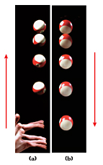
Gravity
As you can see the images of the ball get closer together as the ball moves up.
WHY?
What happens when the ball is at its highest point?

Slide 6
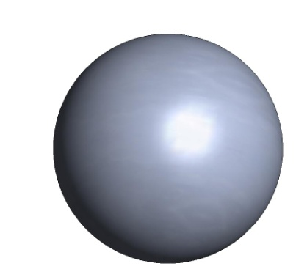
Gravity
Gravity is taking place as an object moves up and moves down.
Velocity
Acceleration
Acceleration
Velocity

Slide 7
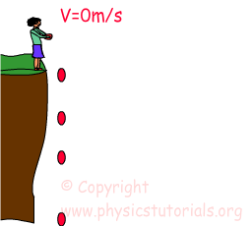
Free Fall
Δy

Slide 8
Formulas
Displacement with unknown constant acceleration:
Δy= ½(v_{i} + v_{f})Δt
Final velocity with constant acceleration:
v_{f} = v_{i} + g⋅Δt
Displacement with known constant acceleration:
Δy= v_{i}⋅Δt + ½a⋅(Δt)²
Final velocity after any displacement
v_{f}²=v_{i}² + 2a⋅Δy

Slide 9
Practice
List known and unknown values:

Slide 10
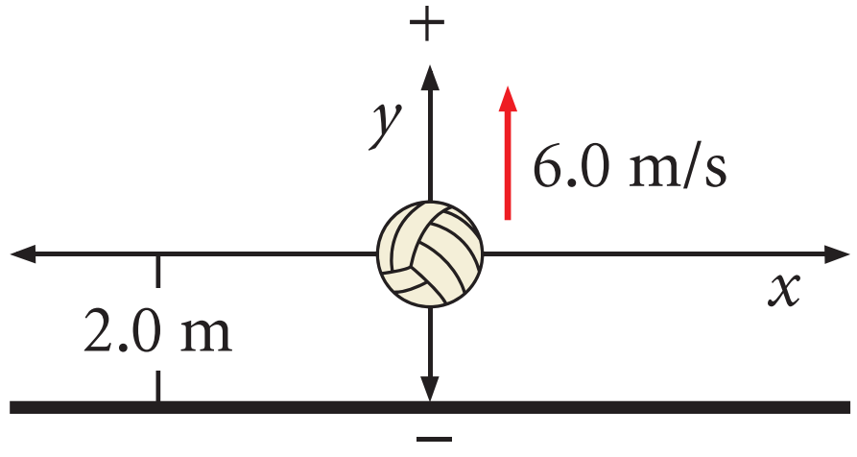
Practice
Draw a diagram:
What equation will be used?

Slide 11
Practice
Solve:

Slide 12
Your Turn…

